Slide 1

Android App Development Session 1

Slide 2
Contents
Introduction
Why android?
Android architecture.
How to start development?
Prerequisites.
Major components.
<Code/>

Slide 3
Introduction
Android
a mobile operating system developed by Google,
based on a modified version of the Linux kernel and other open source software
designed primarily for touchscreen mobile devices such as smartphones and tablets.
Development
The first beta version of the Android Software Development Kit (SDK) was released by Google in 2007 where as the first commercial version, Android 1.0, was released in September 2008.
The source code for Android is available under free and open source software licenses.

Slide 4
Why Android?
Open Source
Larger Developer and Community Reach
Increased Marketing
Reduced Cost of Development
Higher Success Ratio (more than 70% users)
Rich Development Environment (Android Studio)

Slide 5
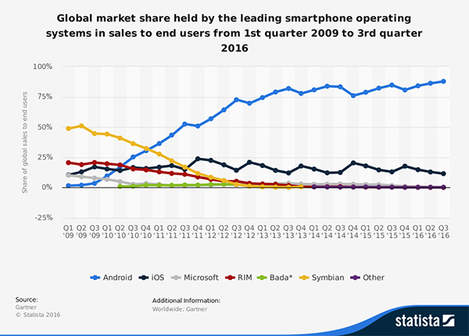
Why Android?

Slide 6
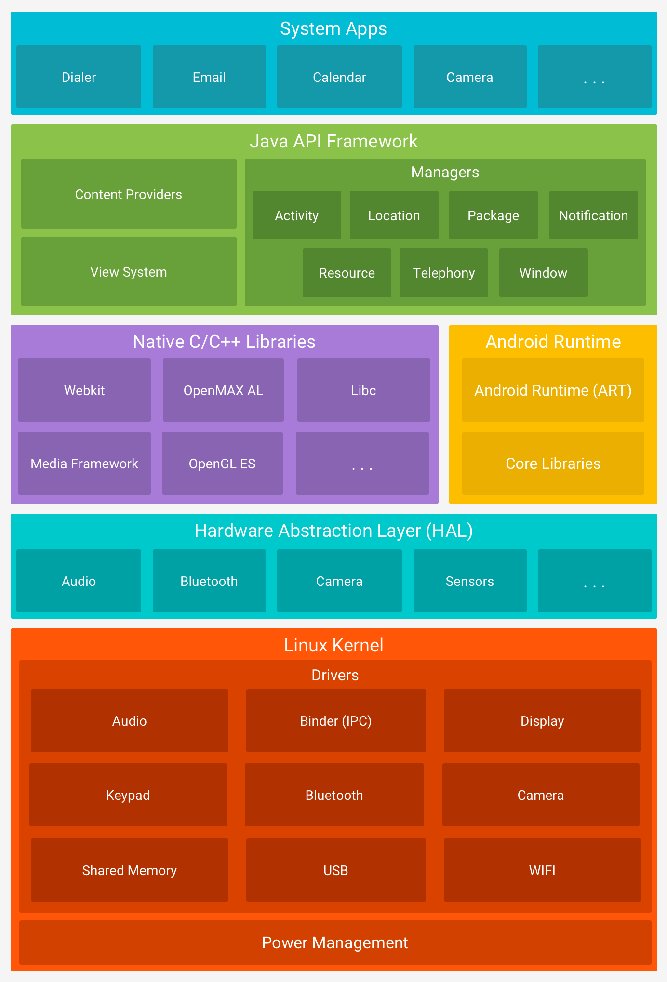
Android Architecture

Slide 7
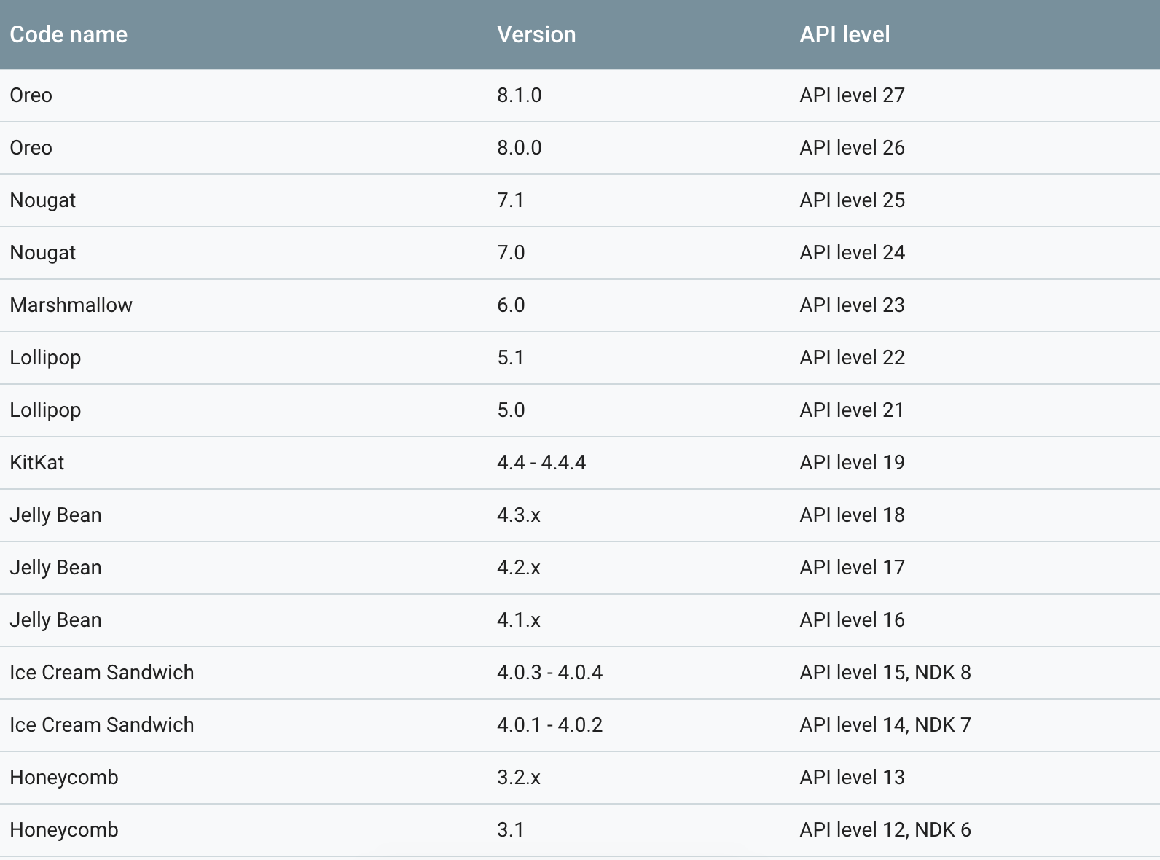
API Levels

Slide 8
Development
Native Application Development
Java
Kotlin
C++
Cross Platform Application Development
React Native
Xamarin
Native Script
Ionic
Phonegap

Slide 9
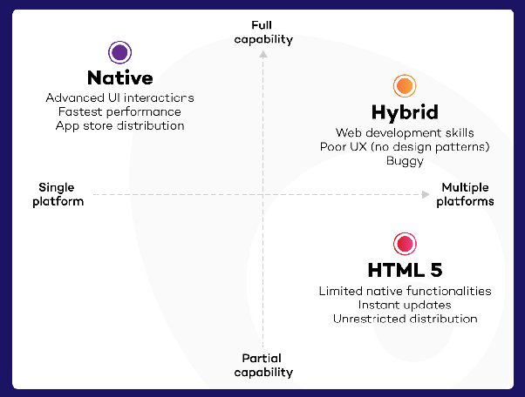
Development

Slide 10
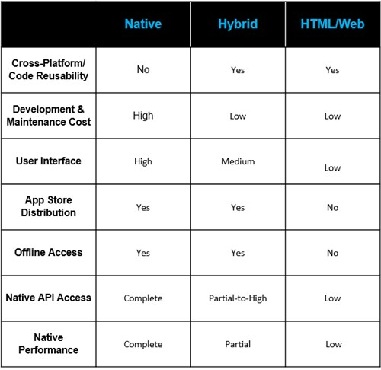
Development

Slide 11
Prerequisites
Object Oriented Programming Language (Preferred Java or Kotlin)
Android Studio
Emulator or Android Device (version > 4.1)

Slide 12
Major Components
Activities
Services
Broadcast Receivers
Content Providers

Slide 13
Activities
Represents a single screen with a user interface,
In-short Activity performs actions on the screen.
For example,
an email application might have one activity that shows a list of new emails, another activity to compose an email, and another activity for reading emails.

Slide 14
Services
A component that runs in the background to perform long-running operations.
For example,
a service might play music in the background while the user is in a different application, or it might fetch data over the network without blocking user interaction with an activity.

Slide 15
Broadcast Receivers
Respond to broadcast messages from other applications or from the system.
For example,
Showing notification of message when user is playing game.
Ringing a phone while using other application.

Slide 16
Content Providers
Component supplies data from one application to others on request.
Such requests are handled by the methods of the ContentResolver class.
The data may be stored in the file system, the database or somewhere else entirely.
For example:
Contacts stored in phone memory.

Slide 17
Additional Components
Fragments
Represents a portion of user interface in an Activity.
Intents
Messages wiring components together.
Resources
External elements, such as strings, constants and drawable pictures.
Manifests
Configuration file for the application.

Slide 18
Let’s Start
<code/>

Slide 19
Thanks!
Any questions?
You can find me at bibesh.manandhar@gmail.com

Slide 20
References!
https://developer.android.com/
https://www.tutorialspoint.com/android/

